Slide 2
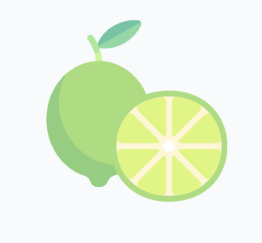


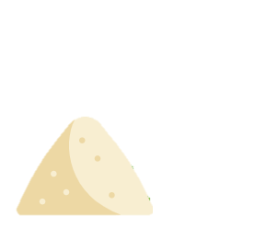
A Premium Malt Cocktail Made Better
Made with Blue Agave Nectar
Made with Lime Juice
No HFCS,
Made with Sugar
Made with Mojito Mint Extract

Slide 3
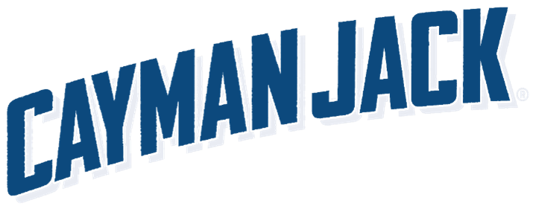
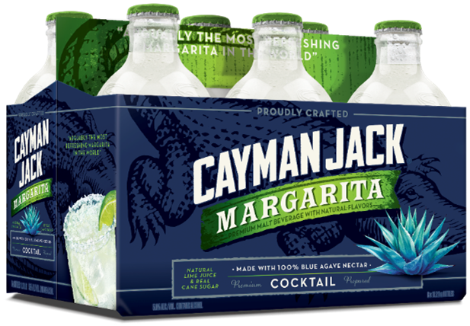
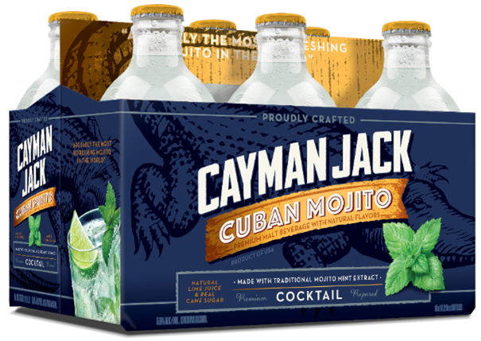
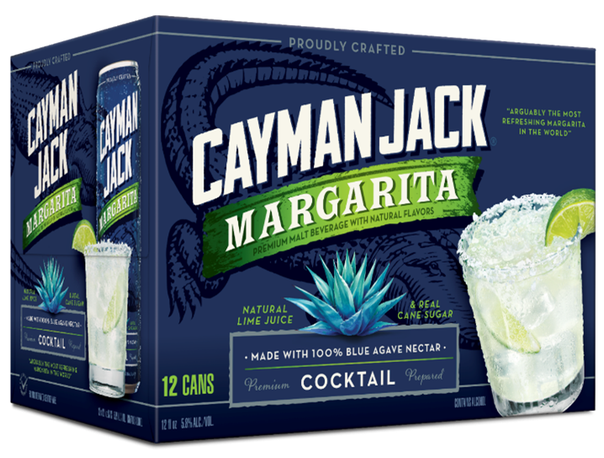
Cayman Jack Media
All Cayman Jack SKUs Continuing to Grow –
12 Pack is Driving Growth
IRI, Total MULO + Conv – 4 Weeks & CYTD ending 06/30/19

Slide 4
Cayman Jack Focus Markets Grow Faster, Turn Harder
Focus Markets
Non-Focus
CE Volume
+56%
+38%
Velocity
(Weekly CEs)
0.59
0.53
2019 is 5th consecutive year of 20+% depletions growth
QLIKVIEW Internal Sales Data, CYTD Ending 7/23/19

Slide 5



Cayman Jack Media
Cayman Jack Strategy Driving Double-Digit Growth
Investment and focus drive incremental growth
National expansion in 2020
National media & PR support

Slide 6
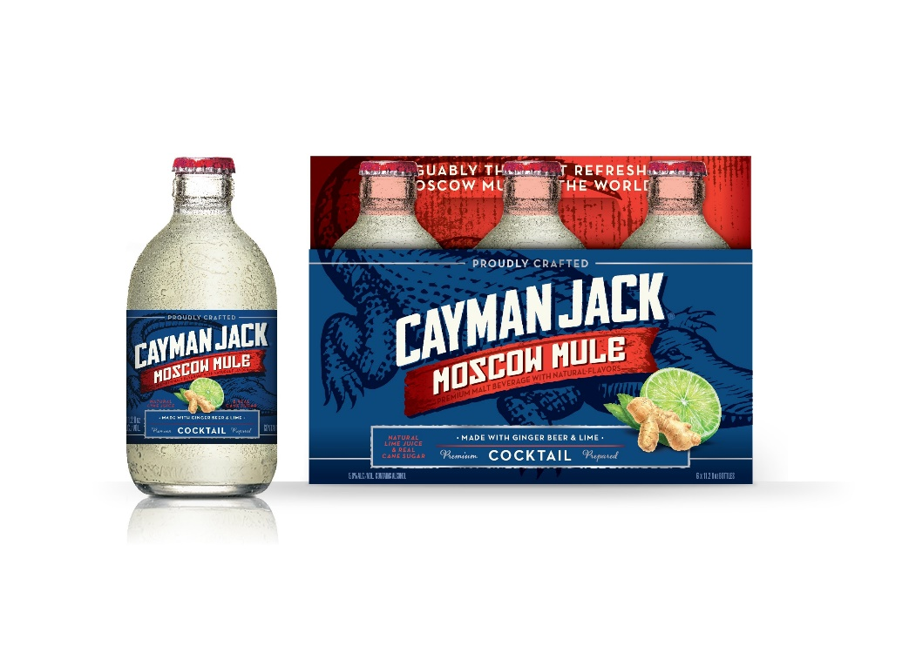
Cayman Jack Moscow Mule 6-Pack
Opportunity
Cayman Jack Continues Growing! – Cayman Jack volume has grown 42% year to date¹
In the Format Consumers Demand! – 6-Pack glass is growing in every channel by over 30%²
The Cocktail Flavors Consumers Love! - Moscow Mule is Consistently ranked in the Top-10 most Popular Cocktails in the World³
Approach
Flavors: Moscow Mule
UPC: TBD
Format: 6-Pack, 12oz Bottles– 5.8% ABV
PTC: $9.99
Timing: Shipping February 1, 2020
Launch States: National
FOB
1) & 2)IRI, Total US MULC, CYTD ending 7/14/19 3) Drinks International Cocktail Ratings 2016-2019 3) IRI, Total US MULO+C, CYTD ending 7/7/19

Slide 7
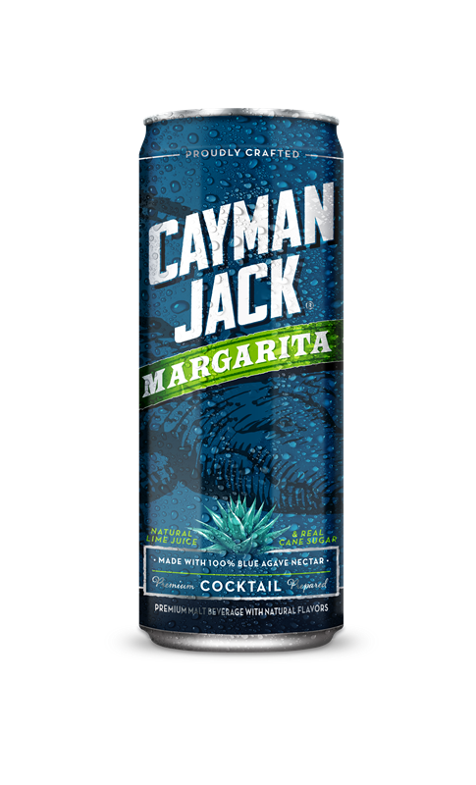

Cayman Jack Margarita 19.2oz Single
Opportunity
Cayman Jack is Growing in C-Store! - Cayman Jack’s highest growth channel is C-Store (+46%)¹
Singles win C-Store! - FMB Singles account for 71% of all FMB dollars²
Cayman Jack Margarita is #1 in Food!³ – Cayman Jack has the #1 growing large format Margarita, now it’s in a format that can push even more growth in C-Store
Approach
Flavor: Margarita
UPC: TBD
Format: Single, 19.2oz – 5.8% ABV
PTC: $2.59
Timing: Shipping February 1, 2020
Launch States: National
FOB
1) IRI, Total US C-Store, 4-weeks ending 7/14/19 2)IRI, Total US MULO+C, CYTD weeks ending 07/14/19 3)IRI

Slide 8
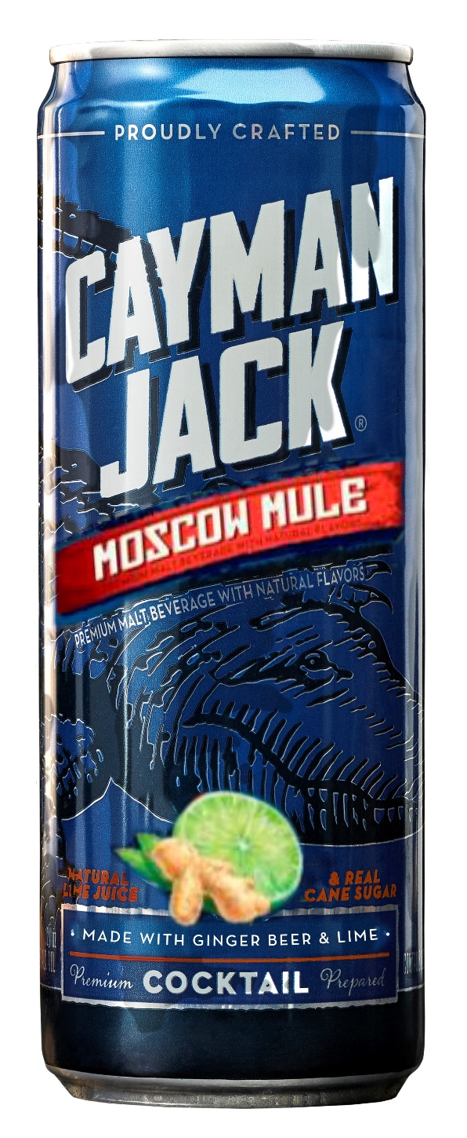
Cayman Jack Moscow Mule 19.2oz Single
Opportunity
Cayman Jack is Growing in C-Store! - Cayman Jack’s highest growth channel is C-Store (+46%)¹
Moscow Mule is Consistently ranked in the Top-10 most Popular Cocktails in the World²
Singles win C-Store - FMB Singles account for 71% of all FMB dollars³
Approach
Flavor: Moscow Mule
UPC: TBD
Format: Single, 19.2oz – 5.8% ABV
PTC: $2.59
Timing: Shipping February 1, 2020
Launch States: National
FOB
1) IRI, Total US C-Store, 4-weeks ending 7/14/19 2) Drinks International Cocktail Ratings 2016-2019 3) IRI, Total US MULO+C, CYTD ending 7/7/19

